Slide 1
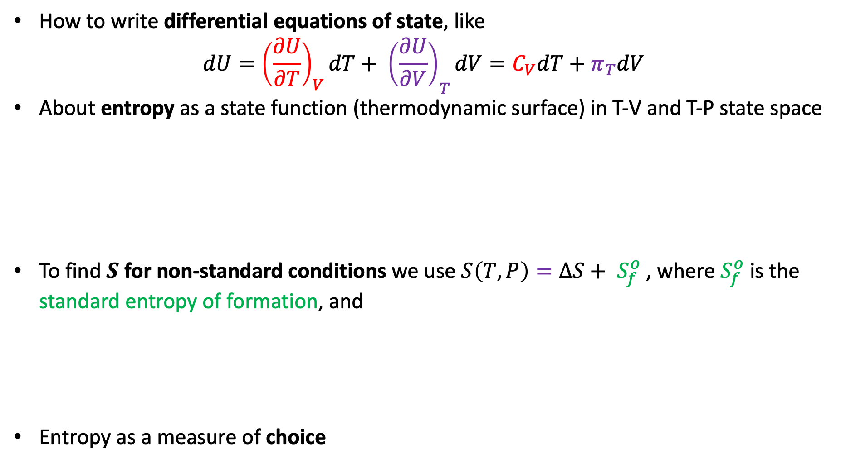
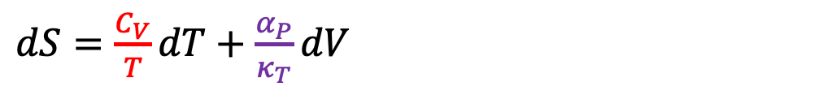
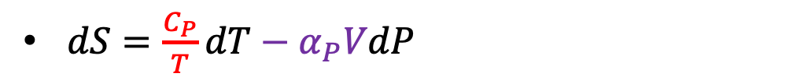
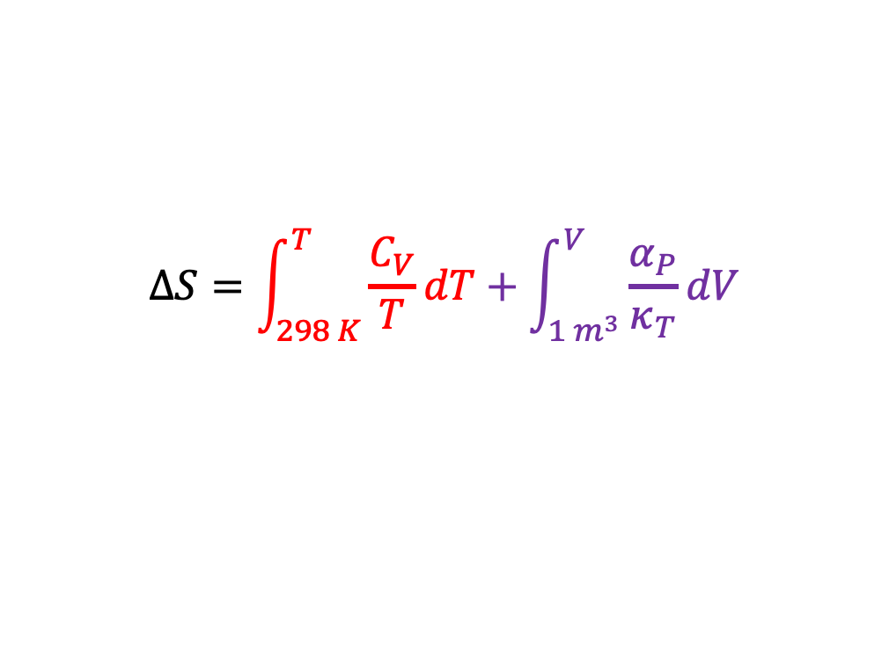
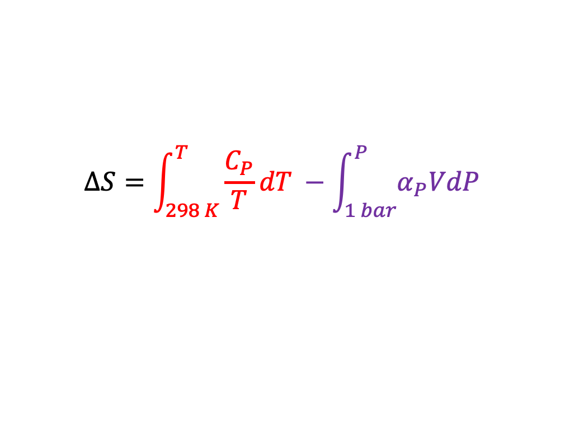
What we learned last time …
How to write differential equations of state, like
$$dU={{\left(\frac{∂U}{∂T}\right)}_{V}dT+ \left(\frac{∂U}{∂V}\right)}_{T}dV=C_{V}dT+π_{T}dV$$
About entropy as a state function (thermodynamic surface) in T-V and T-P state space
To find $S$ for non-standard conditions we use $S\left(T,P\right)={ΔS+ S}_{f}^{o}$ , where $S_{f}^{o}$ is the standard entropy of formation, and
Entropy as a measure of choice
$dS=\frac{C_{P}}{T}dT−α_{P}VdP$
$dS=\frac{C_{V}}{T}dT+\frac{α_{P}}{κ_{T}}dV$
or
$$ΔS=\int_{298 K}^{T}{\frac{C_{P}}{T}dT} −\int_{1 bar}^{P}{α_{P}VdP}$$
$$ΔS=\int_{298 K}^{T}{\frac{C_{V}}{T}dT}+\int_{1 m^{3}}^{V}{\frac{α_{P}}{κ_{T}}dV}$$
or

Slide 2
What we learned last time …
How to write differential equations of state, like
$$dU={{\left(\frac{∂U}{∂T}\right)}_{V}dT+ \left(\frac{∂U}{∂V}\right)}_{T}dV=C_{V}dT+π_{T}dV$$
About entropy as a state function (thermodynamic surface) in T-V and T-P state space
To find $S$ for non-standard conditions we use $S\left(T,P\right)={ΔS+ S}_{f}^{o}$ , where $S_{f}^{o}$ is the standard entropy of formation, and
Entropy as a measure of choice
$dS=\frac{C_{P}}{T}dT−α_{P}VdP$
$dS=\frac{C_{V}}{T}dT+\frac{α_{P}}{κ_{T}}dV$
or
$$ΔS=\int_{298 K}^{T}{\frac{C_{P}}{T}dT} −\int_{1 bar}^{P}{α_{P}VdP}$$
$$ΔS=\int_{298 K}^{T}{\frac{C_{V}}{T}dT}+\int_{1 m^{3}}^{V}{\frac{α_{P}}{κ_{T}}dV}$$
or

Slide 3
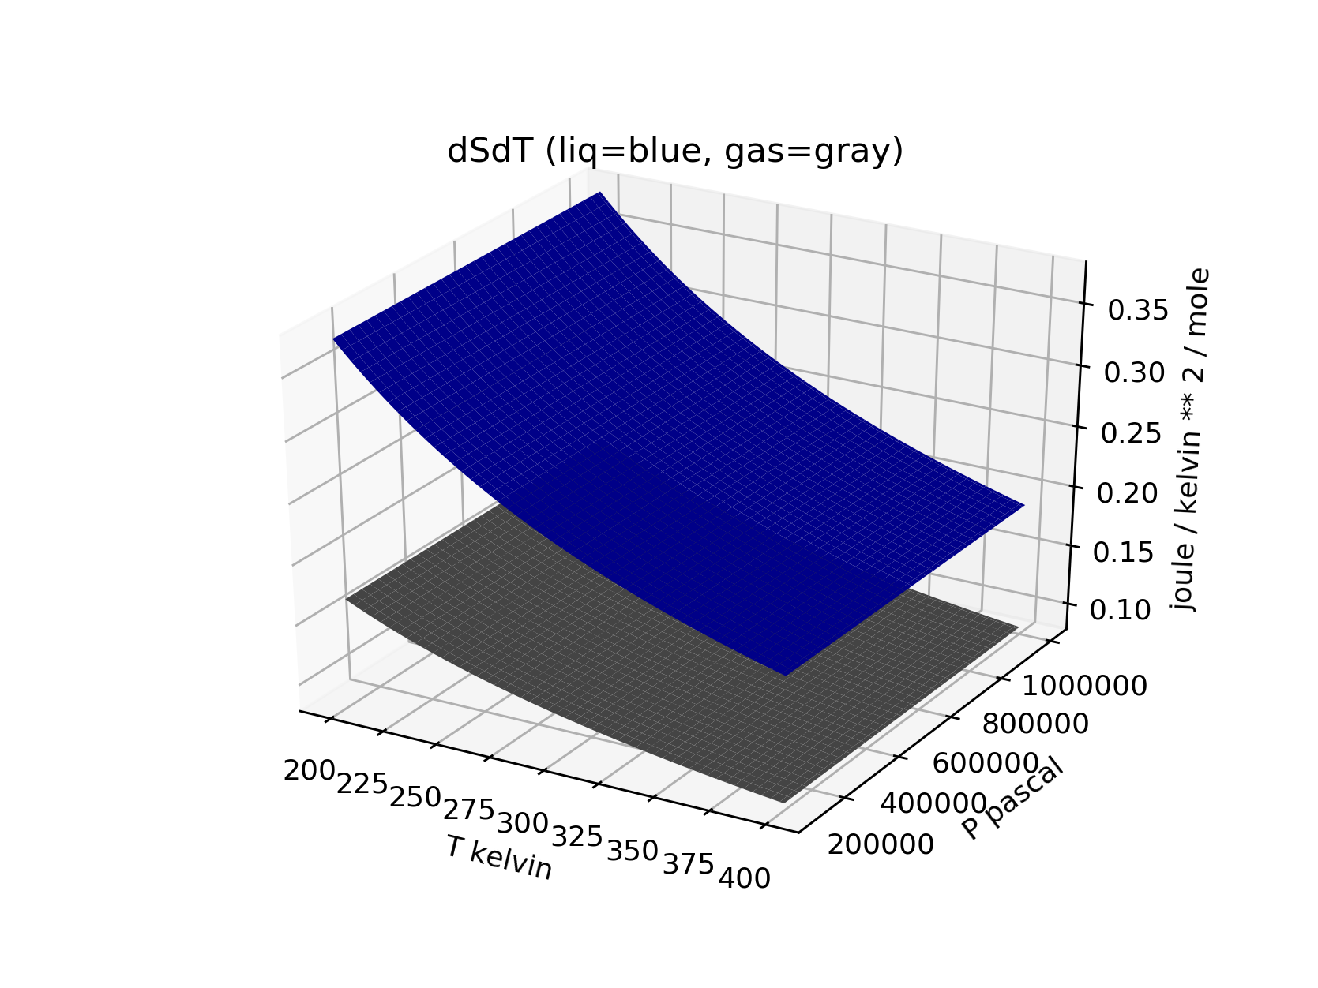
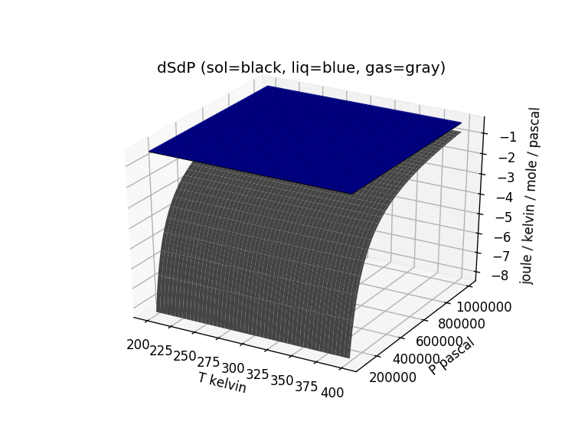
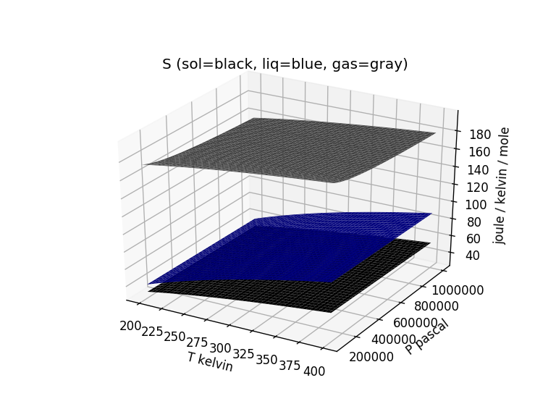
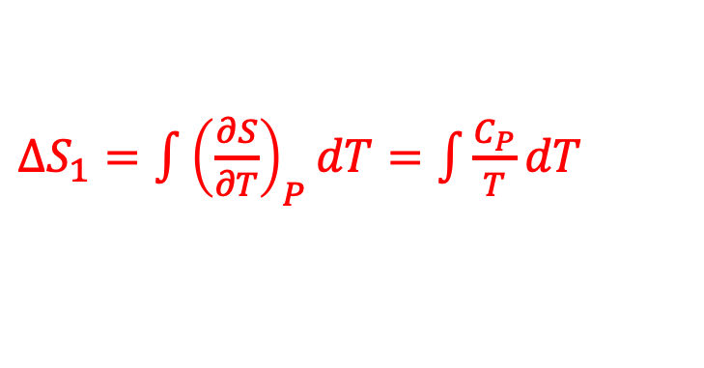




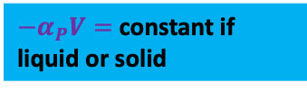

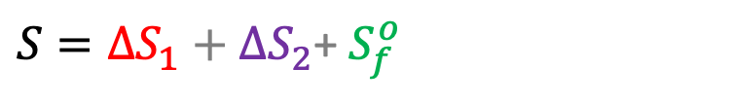

Cruising (constructing) S(T,P) by integrating over temperature and pressure
${−α}_{P}V=$constant if liquid or solid
$\frac{C_{P}}{T}$
${−α}_{P}V= −\frac{R}{P}$ if a gas
$${−α}_{P}V$$
$∆S_{1}=\int{{\left(\frac{∂S}{∂T}\right)}_{P}dT}=\int{\frac{C_{P}}{T}dT}$
$∆S_{2}=\int{{\left(\frac{∂S}{∂P}\right)}_{T}dP}=−\int{α_{P}VdP}$
$${\left(\frac{∂S}{∂P}\right)}_{T}$$
$${\left(\frac{∂S}{∂T}\right)}_{P}$$
$S=∆S_{1}+∆S_{2}$+ $S_{f}^{o}$

Slide 4
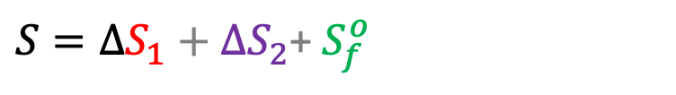
Cruising (constructing) S(T,P) by integrating over temperature and pressure
${−α}_{P}V=$constant if liquid or solid
$\frac{C_{P}}{T}$
${−α}_{P}V= −\frac{R}{P}$ if a gas
$${−α}_{P}V$$
$∆S_{1}=\int{{\left(\frac{∂S}{∂T}\right)}_{P}dT}=\int{\frac{C_{P}}{T}dT}$
$∆S_{2}=\int{{\left(\frac{∂S}{∂P}\right)}_{T}dP}=−\int{α_{P}VdP}$
$${\left(\frac{∂S}{∂P}\right)}_{T}$$
$${\left(\frac{∂S}{∂T}\right)}_{P}$$
$S=∆S_{1}+∆S_{2}$+ $S_{f}^{o}$

